Slide 1
Predicting Medicare Spending
Bobby nahar

Slide 2

Healthcare in a nutshell…
Notes:
Everyone’s experience with Healthcare

Slide 3
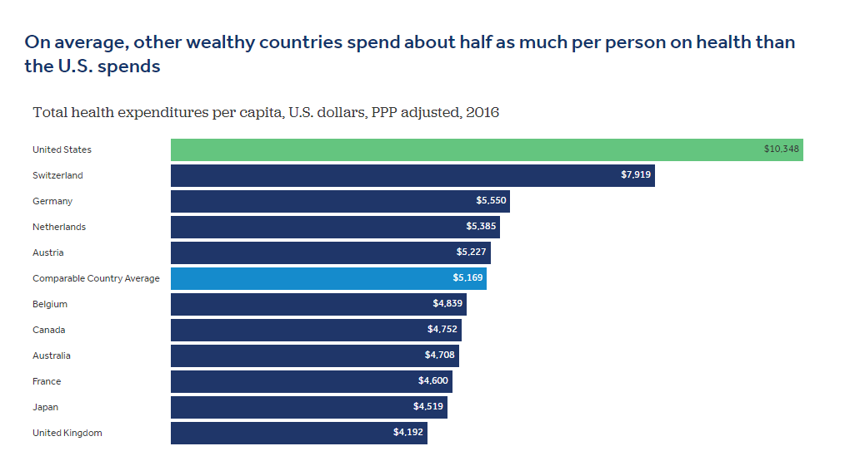
Problem: Rising Healthcare Costs
Source: Health System Tracker

Slide 4
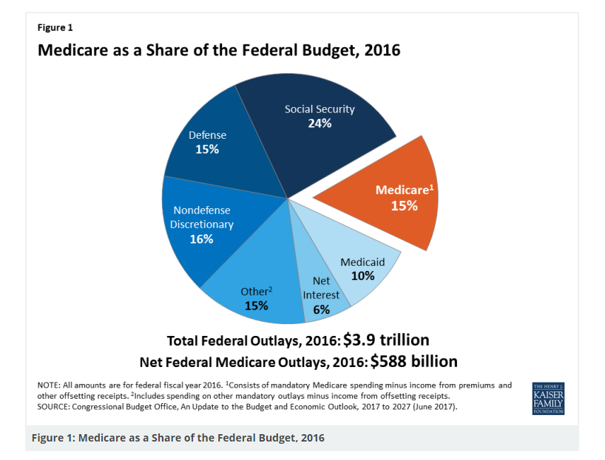
Problem: Rising Healthcare Costs
Source: Kaiser Family Foundation
Notes:
Healthcare comprises of a large portion of government spending

Slide 5
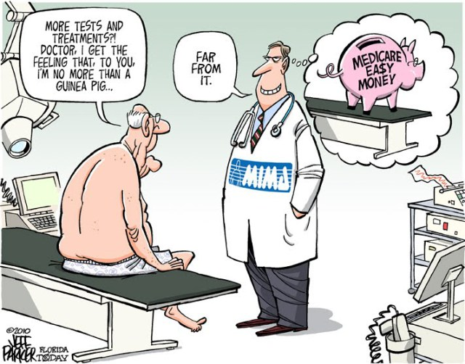
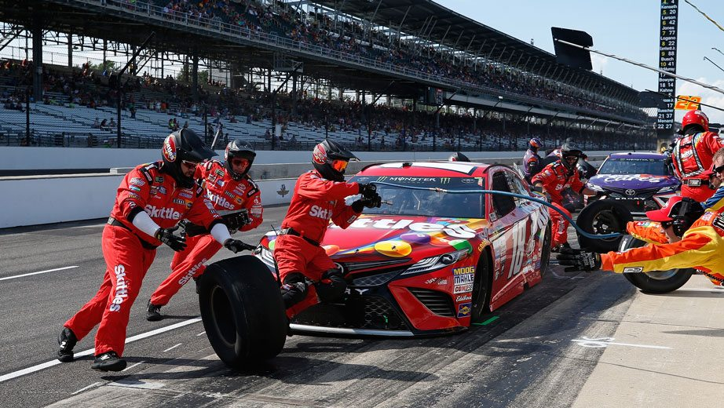
Solution: Change how hospitals are paid
Old Model: Fee-For-Service
New Model: Value-Based Care
Charge every time patient comes to hospital and for every test
No reward for quality
Incentive: see patient as much as possible → unnecessary visits and tests
Hospital is paid based on outcome
Incentives or penalties for quality (Medicare can withhold payment for hospital’s with poor quality)
Coordination amongst clinical staff and specialists- like a pit crew
Incentive: keep population healthy

Slide 6
Value Based Health care
Value = Health Outcomes /cost of delivering the outcomes
* Source: New England Journal of Medicine

Slide 7
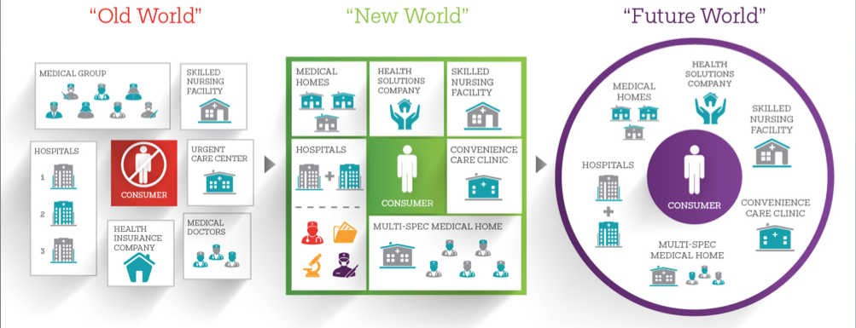
Solution: Change how hospitals are paid
Value Based Care = Coordinated Care that focuses on quality and cost

Slide 8
Project Focus: Hospital Efficiency
Quality incentives/ penalties for hospitals are based on:
Medicare Spending per Beneficiary (MSPB):
Measure for hospital efficiency
Average amount that a hospital charges Medicare for its patients
Risk-adjusted for differences in geography and how sick hospital patients are
Divided by Median Spending per Beneficiary for the nation
Score of 1.0 = In line with national median
Lower score is better: more cost-efficient hospital

Slide 9
Project Goal
Aim: Determine which metrics, hospitals with high Medicare Spending per Beneficiary (MSPB) scores, should focus on to improve their scores and increase their efficiency
Method: Predict Medicare Spending per Beneficiary (MSPB) Using:
Type of Hospital (H): For Profit or Not-For-Profit
Various Quality Measures (Q):
Patient Review Scores ( Q1)
Readmission Rates ( Q2)
Hospital Safety Scores (Q3)
Measures of Timeliness and Effectiveness of Care: how quickly hospital treats patients (Q4)
Hypothesis: Hospitals with lower quality metrics will be less efficient

Slide 10
Predictive Function
MSPB= $Hβ_{0}+Q_{1}β_{1}+{Q_{2}β}_{\begin{aligned}2 \\ \end{aligned}}+{Q_{3}β}_{3}+{Q_{4}β}_{4}$
Type of Hospital (H): For Profit or Not-For-Profit
H=0 → Not-For-Profit Hospital
H=1 → For-Profit-Hospital
Various Quality Measures (Q):
Patient Review Scores ( Q1)
Readmission Rates ( Q2)
Hospital Safety Scores (Q3)
Measures of Timeliness and Effectiveness of Care: how quickly hospital treats patients (Q4)
0 = At or Above National Average for Category
1= Below National Average for Category

Slide 11
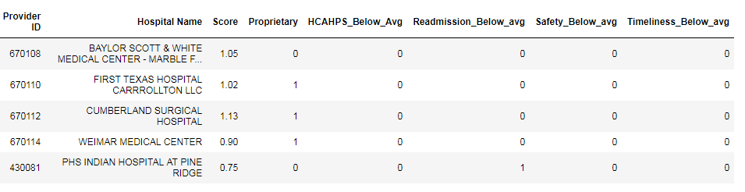
Initial Dataset
Independent Variable (MSPB)
H
Q1
Q2
Q3
Q4
3,152 Hospitals used (only included those with no missing data)
Dependent Variables:
Hospitals were categorized as worse than National average, at National average, or better than National average for different aspects of hospital quality
Created dummy variables focusing on below-average performance
Notes:
The range of scores for my independent variable is: 0-2.7.
The data for my data set has been obtained from Medicare
Type of Hospital (H): For Profit or Not-For-Profit
Various Quality Measures (Q):
Patient Review Scores ( Q1)
Readmission Rates ( Q2)
Hospital Safety Scores (Q3)
Measures of Timeliness and Effectiveness of Care: how quickly hospital treats patients (Q4)
For dependent variables:
H: 0=Not for Profit
1=For profit
Q: 0= At /above average
1= below average

Slide 12
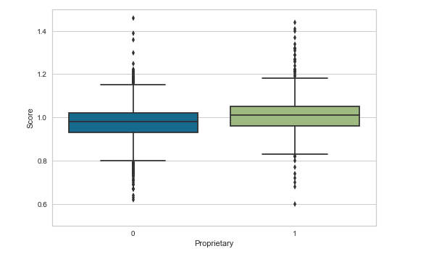
Data Exploration Hospital Type
For-Profit (Proprietary) hospitals had generally higher (worse) MSPB scores…*
* Extreme outliers not shown
Notes:
This is Box and Whiskers plot showing that
For-Profit (Proprietary) hospitals had generally higher (worse) MSPB scores…*

Slide 13
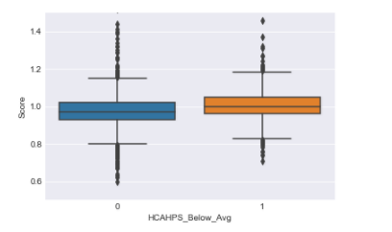
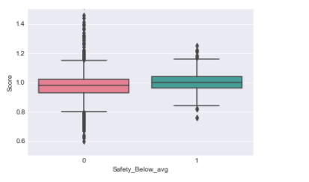
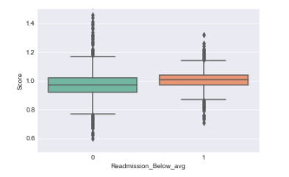
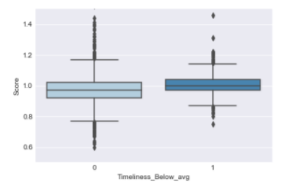
Data Exploration: Quality Scores
Patient Reviews (Q1)
Hospital Safety Score (Q3)
Readmission Rates (Q2)
Timeliness Score (Q4)
* Extreme outliers not shown
Notes:
Form these B& W hospitals with below average quality scores have worse (higher) MSPB scores in general

Slide 14
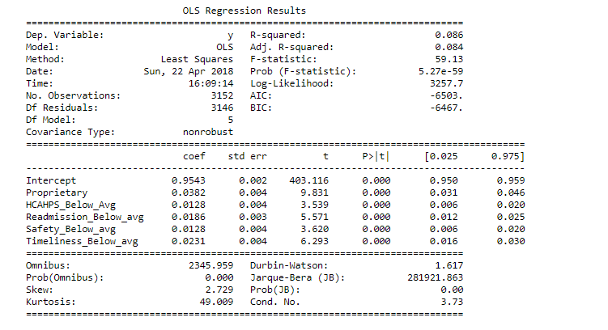
Initial Results

Slide 15
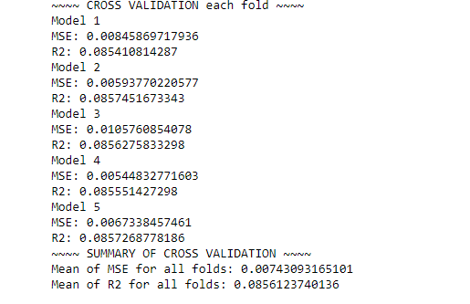
Initial Results
Low MSE and Low R-Squared: Something is wrong here

Slide 16
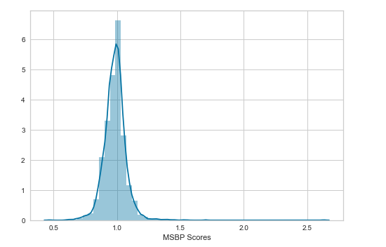
Initial Model reflection
Interpreting low R-Squared and low MSE:
Normally when R-Squared is low, your error is high
When variance of dependent variable is very low you can have low R-Squared and low MSE at the same time
Other Observations:
The target variable (MSPB Score) has undergone numerous transformations by Medicare
More “raw” data for dependent variable could be better
More specific quality metrics instead of dummies for independent variables could be better (ex: actual readmission rates vs comparison to average) could yield better results

Slide 17
Round 1
Baseline
Round 2
More “raw” target and input variables

Slide 18
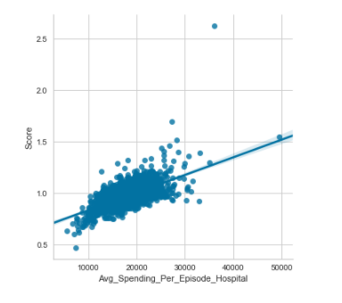
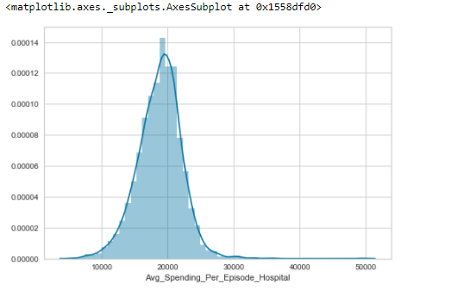
Second Round
Steps taken to improve model:
Changed Target Variable: Found a more “raw” version of the Medicare Spending Per Beneficiary (MSPB) score called “Average Spending Per Episode”
This variable is decently correlated with the MSPB scores
Old Target
New Target- More Spread-Out
Notes:
My new target is an input into the MSPB scores- basically a proxy

Slide 19
Second Round
Steps taken to improve model:
Found actual scores for my input variables which fell under the various quality categories I had used earlier. For example I found actual average readmission rates rather than having a variable comparing readmission to the average
These measures were taken from a total of 4 different files that were included in a larger file-set from the Centers for Medicare and Medicaid Services
There were multiple files and a total of at least 50 variables I could have potentially used
Narrowed them down by first thinking through what I figured would have the greatest impact on Medicare Spending and then seeing which variables had the highest correlations with my target to narrow then further

Slide 20
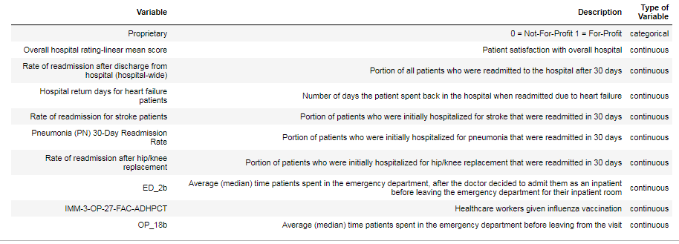
Second Round
Q1
Q10
Q50
Selected Variables

Slide 21
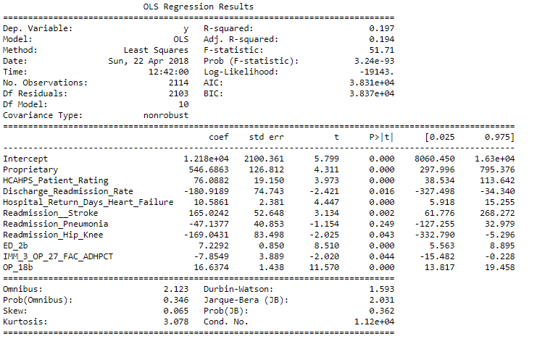
Second Round ( Results)
The R-Squared is much better here (was previously close to 0)
However the coefficients do not make too much sense here
Three of the readmission rate variables have a negative coefficient → as readmission rates go up then spending goes down
The opposite should be true
Evidence of multicollinearity amongst readmission variables

Slide 22
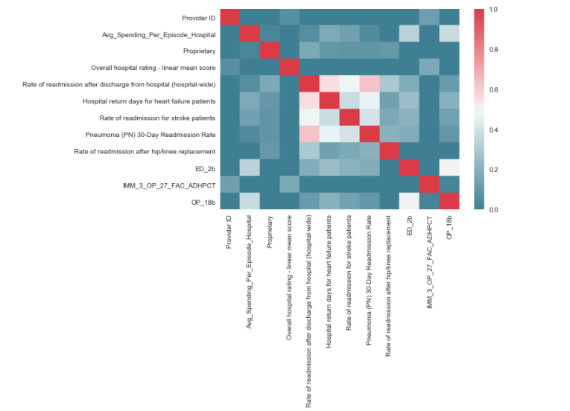
Second Round: Reflection
Correlation Matrix of Input Variables
Had an original correlation threshold of 0.75 when testing for multicollinearity
Clearly this was too generous
Decided to eliminate all readmission variables other than heart failure as heart failure is the most common cause for hospitalization in the U.S.
Notes:
My initial assumption was that a correlation threshold of 0.75 would suffice

Slide 23
Round Three
Round 1
Baseline
Round 2
More “raw” target and input variables
Round 3
Aimed to resolve multicollinearity

Slide 24
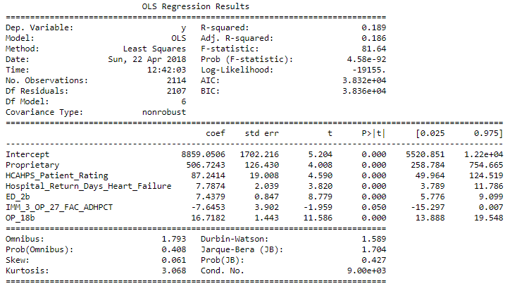
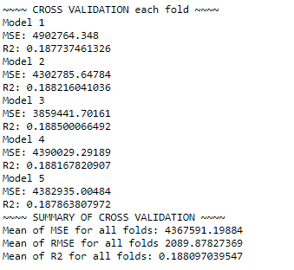
Round Three

Slide 25
ROUND 3: Observations
Almost no drop in R-Squared from Round Two
Unclear effects from unnecessary variables have been eliminated
It is Clear that: for-profit hospitals have more spending for Medicare Patients than Not-For-Profit hospitals
Patient Satisfaction seems to have a higher weighting than readmission or timeliness measures

Slide 26
Conclusion/ Next Steps
This data was only for Medicare Patients – perhaps the observed relationships could be different with a more general population
I focused a lot on feature reduction – with over 50 initial variables perhaps I could have included more of them to increase the accuracy of my model.
My first method to reduce variables was using my own intuition- perhaps there were some variables I felt were not important which might actually be
A lot of the variables (including my target and some inputs) were already transformed or modified by the Centers for Medicare and Medicaid → more difficult for predictions
Time Disparity : The input and target variables were measured during different periods (ex: some from 2015, some from 2016 to predict a target variable that was measured from 1/1/2016 to 12/31/2016)
Just did an OLS- would like to try other regressions or other models

Slide 27
Acknowledgements

